Slide 1
BIOTRANSFORMATION & EXCRETION
BY
DR.G.AARTHIPRIYANKA
POST GRADUATE
DEPARTMENT OF PHARMACOLOGY

Slide 2
BIOTRANSFORMATION
Chemical alteration of drug in the body
Non polar lipid soluble -> polar lipid insoluble =excreted
Primary site- liver
Other sites-kidney,intestine,lungs,plasma
Biotransformation leads to
Inactivation – active ->inactive= excreted
Active metabolite from an active drug e.g. Allopurinol-Alloxanthine
Activation of inactive drug e.g. Levodopa-Dopamine

Slide 3
Biotransformation can be classified into
PHASE 1 – NONSYNTHETIC/FUNCTIONALIZATION REACTION
PHASE 2 – SYNTHETIC/CONJUGATION REACTION
PHASE 1 REACTIONS: PHASE 2 REACTIONS:
Oxidation - glucuronide conjugation
Reduction - acetylation
Hydrolysis - methylation
Cyclization - sulfate conjugation
Decyclization - glycine conjugation
- glutathione conjugation
- ribonucleoside/nucleotide synthesis

Slide 4
PHASE 1 REACTIONS
Functional group is generated or exposed
May be active or inactive

Slide 5
OXIDATION
N-Dealkylation-Codeine,caffeine
O-Dealkylation-Codeine,Indomethacin
Aliphatic chain hydroxylation – phenobarbitone,ibuprofen
Aromatic chain hydroxylation – phenobarbitone,phenytoin
N-oxidation- chlorpheniramine,dapsone
S-oxidation- chlorpheniramine,cimetidine
Deamination- Diazepam,Amphitamine

Slide 6
CYTOCHROME P 450
Families – 1,2,3 1 2 3
Subfamilies – A,B,C 1A1 2A6 3A4
Isoenzymes – 1,2,3 1A2 2B6 3A5
1B1 2C8
2C9
2C19
2D6
2E1

Slide 7
FLAVIN MONOOXYGENASE
Liver
Not induced or inhibited by other drugs
Not involving drug interactions
E.g. cimetidine,ranitidine,clozapine

Slide 8
EPOXIDE HYDROLASE
Detoxify epoxide metabolites of some drugs generated by CYP oxygenases
E.g. carbamazepine

Slide 9
REDUCTION
CYP P 450
AZO & NITRO REDUCTION –e.g. chloramphenicol
CARBONYL REDUCTION – e.g. naloxone

Slide 10
HYDROLYSIS
Ester + water → Acid + Alcohol with the help of esterase
Amidase
peptidase

Slide 11
CYCLIZATION & DECYCLIZATION
Formation of ring structure -opening of ring structure
E.g. Prontosil e.g. Phenytoin

Slide 12
PHASE 2 REACTIONS
Conjugate of drug / phase-1 metabolite
+
Endogenous substrate (carbohydrate + aminoacid)
||
Polar highly ionized organic acid
excreted through urine / bile

Slide 13
GLUCURONIDE CONJUGATION
Hydroxyl or carboxylic acid conjugated with glucuronic acid (glucose)
Not only drugs- endogenous substrate like steroids,bilirubin,thyroxine
Increases molecular mass- excretion in bile
Hydrolysed by bacteria in the gut
Drug is reabsorbed
Enterohepatic cycling-prolongs its action

Slide 14
TRANSFERASES - COFACTOR - EXAMPLE
Glucuronide - UDP Glucuronic acid - e.g. Acetaminophen,morphine
Acetylation - Acetyl COA -e.g. sulfonamides,isoniazid
Methylation -S-Adenosyl methionine-e.g.levodopa,captopril
Sulfation-3-phosphor adenosyl 5-phospho sulfonades-e.g.steroids
Glutathione-cysteine/glutathione-e.g.paracetamol,busulfan
Glycine – glycine –e.g. salicylates
Ribonucleoside – cancer chemotherapy
GILBERT SYN/CRIGGLER NAGAR SYN

Slide 15
Simultaneous/sequential metabolism
Drug- phase 1 – phase 2 – excreted
Drug – phase 2 - excreted

Slide 16
DRUG METABOLIZING ENZYMES
Microsomal( ER) Nonmicrosomal enzymes (cytoplasm/mito)
CYP P 450 - amidase,esterase,peptidase
Glucuronyl transferase

Slide 17
HOFMANN ELIMINATION
Inactivation of drugs in body fluids by spontaneous molecular rearrangement without help of any enzyme
E.g. Atracurium

Slide 18
INHIBITION OF DRUG METABOLISM
Allopurinol
Omeprazole

Slide 19
MICROSOMAL ENZYME INDUCTION
Phenobarbitone
Isoniazid

Slide 20
FIRST PASS METABOLISM
HIGH first pass metabolism
E.g. propanalol,morphine,lidocaine,steroids

Slide 21
EXCRETION
Urine
Faeces
Exhaled air
Saliva,sweat
Milk

Slide 22
RENAL EXCRETION
Normal GFR-120
Decreases with age
Net renal excretion= glomerular filtration+tubular secretion – tubular reabsorption
Organic acid transport,organic basic transport
Acid urine- alkaline drugs eliminated

Slide 23
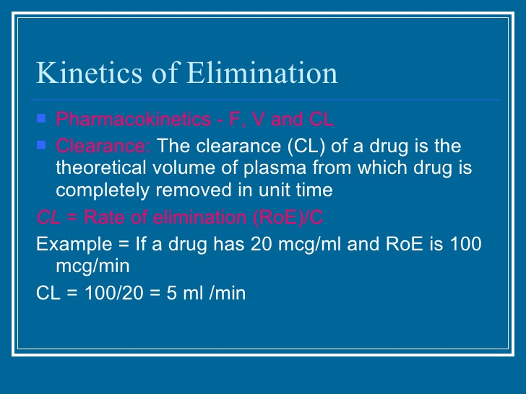

Slide 24
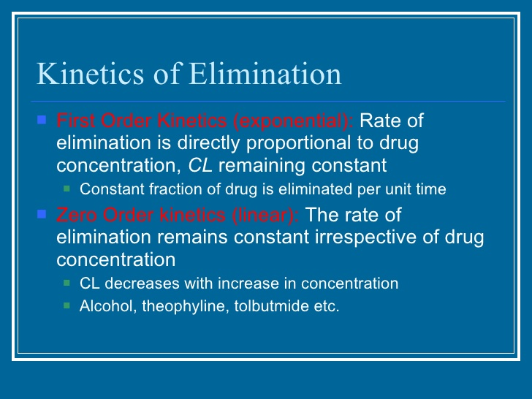

Slide 25
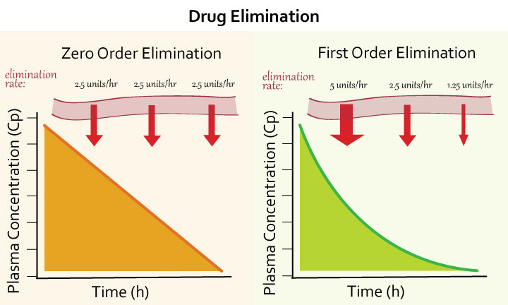

Slide 26
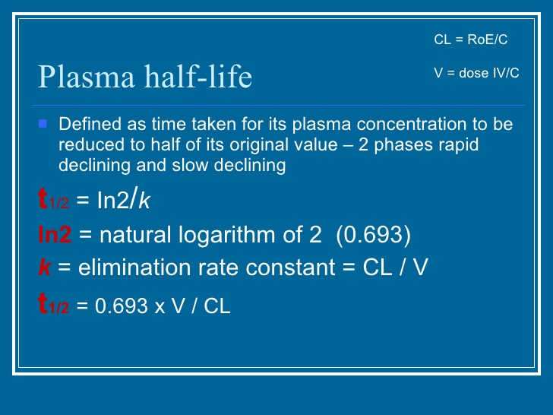

Slide 27
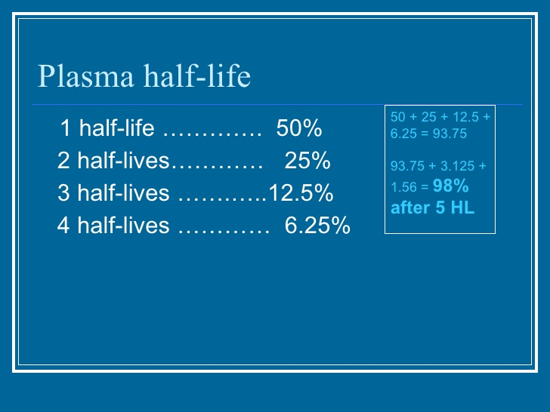

Slide 28
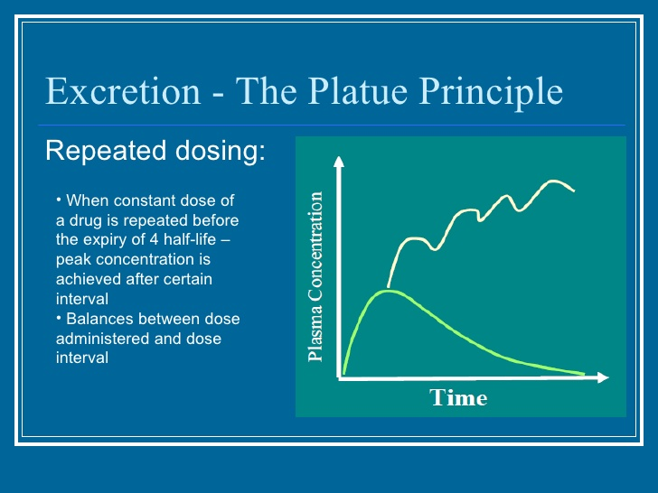

Slide 29
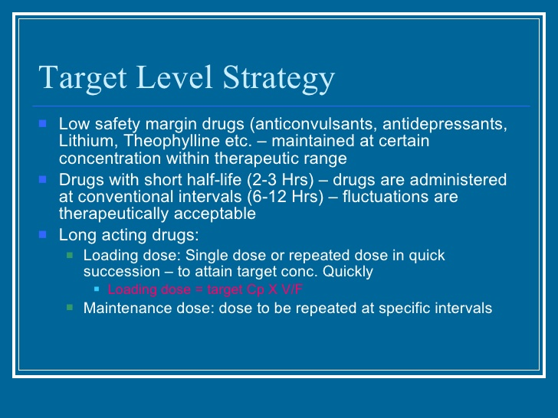

Slide 30
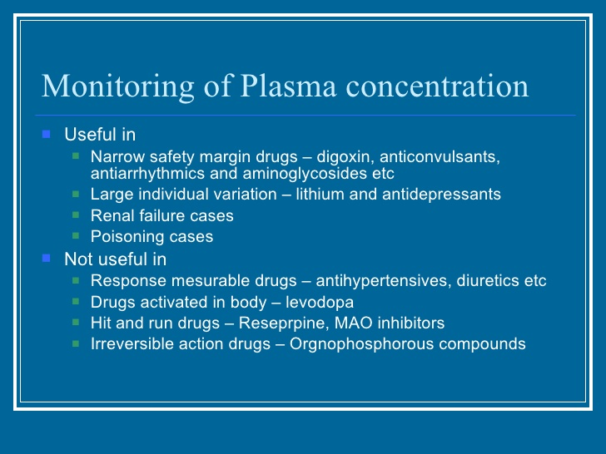

Slide 31
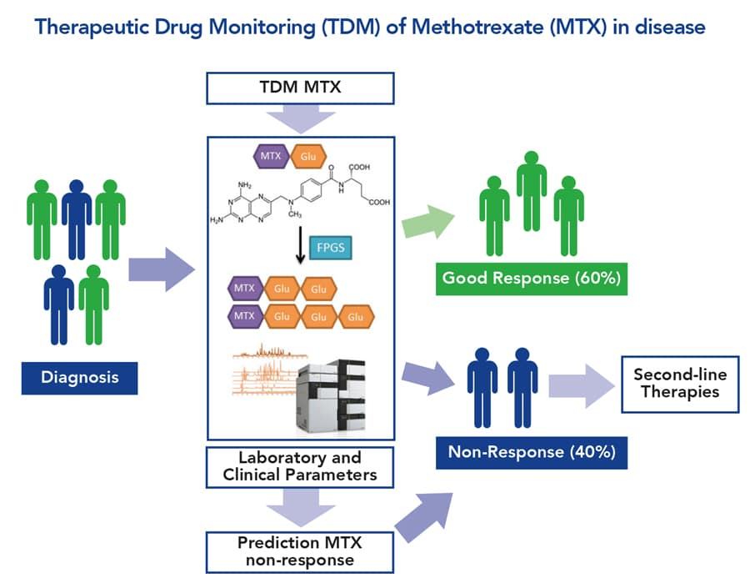

Slide 32
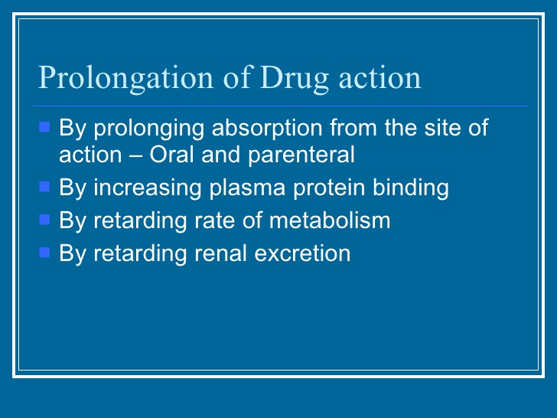

Slide 33
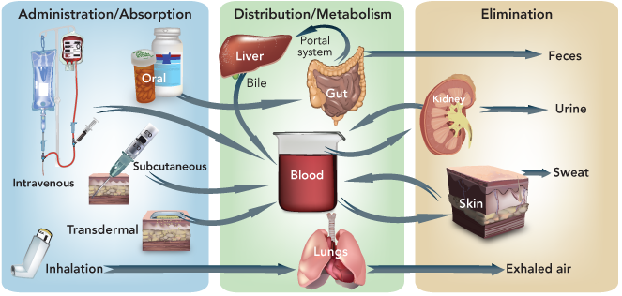
THANK YOU

